Slide 1
Scaffolding backend express
Npm init –y
Npm I express typescript mongoose
Npm I –save-dev nodemon ts-node
npx tsc --init

Slide 2
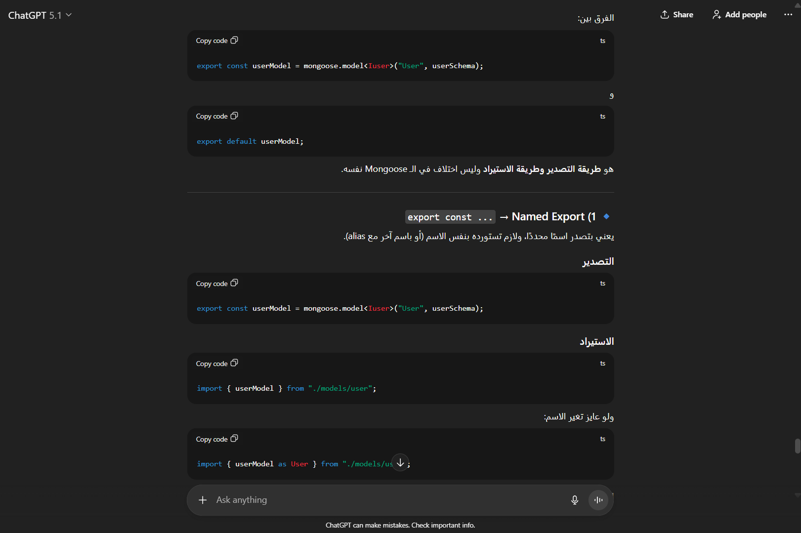

Slide 3
